Slide 1
HOME AUTOMATION
Class:- EC5B
Shine Ali - 59
Rohit Sreekumar - 53
Deepak J Puthukkaden – 20
Govindh B - 32
Giridhar A K - 31

Slide 2
IDEA
¬ The proposed idea for our Mini Project for the academic year 2014-15 is home automation based on the Raspberry Pi.
¬ We intend to implement the following features in our project
* Adaptive Internal Lighting
* Temperature Controlled Air Conditioning
* Automatic External Lighting
* Automatic Water Supply system
* Keypad Enabled Door Lock system
* Interactive Music Player
* Data Logging and analysis

Slide 3
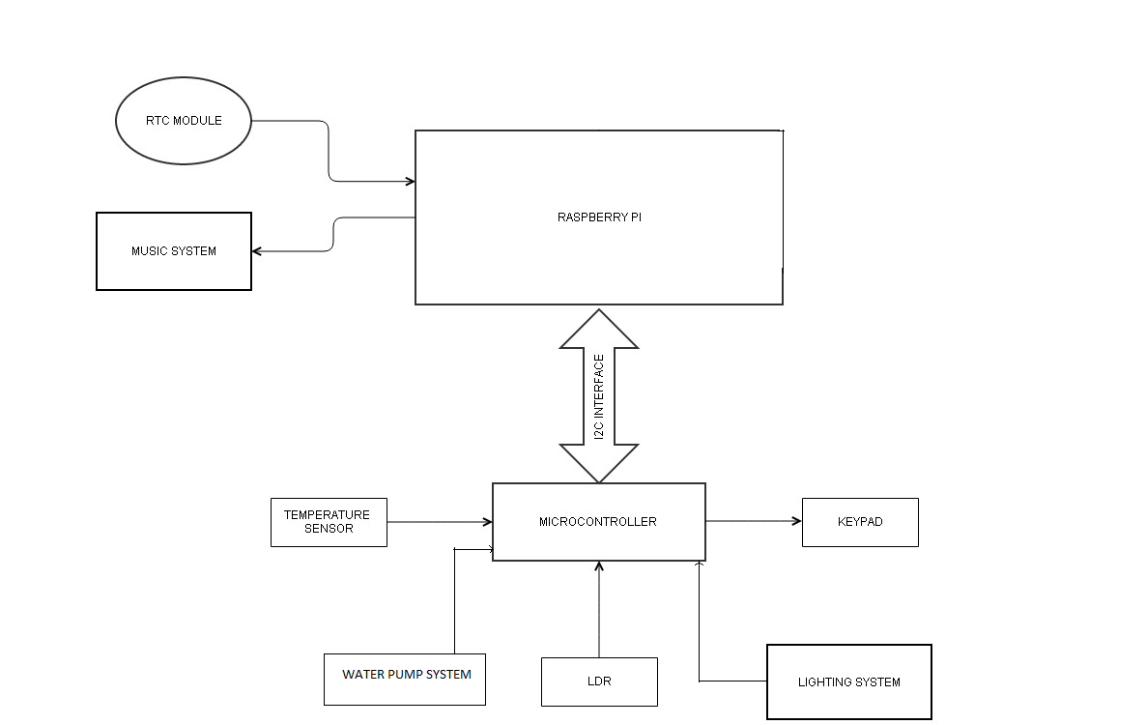
BLOCK DIAGRAM

Slide 4
HARDWARE
Raspberry Pi
DS1307-RTC
LM35-Temp sensor
ATMEGA328P-microcontroller
LDR
LCD

Slide 5
SCHEDULE
MONTH | WEEK NO | OBJECTIVE
July | 2 | Circuit Design
July | 4 | Breadboard Implementation
August | 2 | PCB design and fabrication
August | 4 | Testing and debugging
September | 2 | Final testing and product design
September | 4 | Project Presentation
October | 1 | Project Submission

Slide 6
ESTIMATED EXPENSE
Serial Number | Material | Approx. cost
1. | Raspberry Pi | 2800
2. | Atmega 328P | Sampled
3. | LM35 | Sampled
4. | LDR | 5
5. | DS1307 | Sampled
6. | LCD | 200
7. | Miscellaneous | 500

Slide 7
THANK YOU

